Slide 1
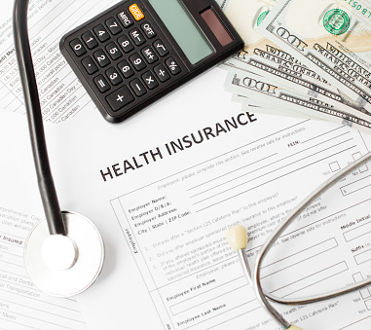
Analysis of Health Insurance Costs

Slide 2
Introduction
This analysis will help insurance companies to learn more about the factors that influence health insurance costs. It would be valuable information that can be used to project future prices for specific groups of people or regions.
Variables focused on the analysis are smoker and sex
Comparison of health insurance costs between smokers and non- smokers’ and for health insurance costs between female and male genders

Slide 3
Data Analyzed
A dataset with insurance prices was used to perform this analysis.
There are 1338 rows and 7 columns. The dataset includes 4 categorical variables (age, sex, smoker, region), 2 continuous variables (bmi, charges) and 1 discrete variable (children).
Link to dataset: https://www.kaggle.com/mirichoi0218/insurance

Slide 4
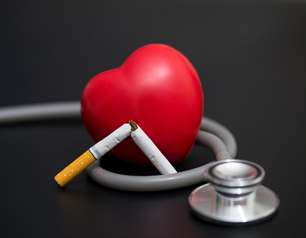
What do we want to prove?
Are smokers’ insurance prices higher than non-smoker’s insurance prices?
Are insurance prices for male gender higher than prices for female gender?
Notes:
An assumption is that Tobacco (tuh·ba·know) users can pay up to 50% or more for health insurance.
Gender can influence the health insurance costs. Another assumption is that men pay more because women live longer than men.
The analysis will help to answer the questions:

Slide 5
Methods
Descriptive Statistic
Visualizations
Box Plot
Pair Plot
Scatter Plot
Correlation test
Two-Sample t-test
Python was the tool used to perform the analysis
Notes:
Descriptive statistic was used to learn more about the insurance prices dataset. Information like mean, count, std, min, max costs
We divided our dataset in two groups for the smoker variable: smoker and non-smoker and for the sex variable; female and male
Created some visualizations like Boxplot to see the difference of insurance costs of our variables smoker and sex and look
Made a pairplot to look for correlations between the variables
Made a scatterplot to visualize a correlation
We ran a correlation test (Pearsonr) and two-sample t-tests to prove the hypothesis so we can reject them or fail to reject them

Slide 6
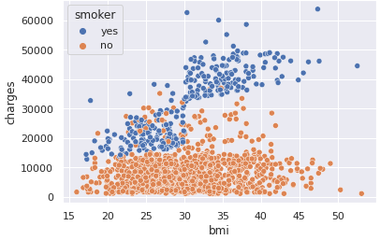
Correlation test BMI VS Charges
Correlation coefficient = 0.806
p value = 5.019668631795185e-64
There is a statistically significant correlation between bmi and charges variables in the population at p<0.05
Notes:
A correlation between bmi and charges was found. In the scatter plot As the bmi increases, the charges will also increase.
The correlation test tell us if there is a linear correlation between two variables and how strong it is.
The 0.806 is close to 1 and means that there is a strong positive correlation between bmi and charges.
The p value is less than .05, this means that there is a significant correlation.

Slide 7
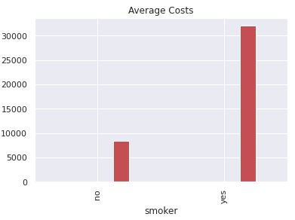
Two sample t-test Health insurance costs of smokers VS health insurance costs of non-smokers
t value=46.664921172723716
p value=8.271435842177219e-283
There is a statistically significant difference between the insurance costs of smokers and non-smokers at p < 0.05
The average insurance costs of smokers are higher than insurance costs of non-smokers
Notes:
We ran a t-test of the two samples and to compare the means of the two samples.
Over the 1338 insured individuals, the average cost for non-smokers was $8434.. However, the average cost for smokers was $32050. Higher 3.8 times
The t value indicates that there is a difference of 46.66 standard deviation between the two means. (Standard deviation measures the spread of a data distribution. The more spread out a data distribution is, the greater its standard deviation.)
The p-value is extremely small, implying that this is a real difference
A p-value less than 0.05 (typically ≤ 0.05) is statistically significant. It indicates strong evidence against the null hypothesis, as there is less than a 5% probability the null is correct (and the results are random).

Slide 8
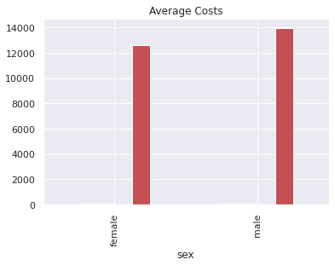
Two sample t-test Female health insurance costs VS Male health insurance costs
t value =2.097546590051688
p value=0.03613272100592976
There is a statistically significant difference between insurance costs for male and insurance costs for female at p < 0.05
The insurance costs for male are higher than insurance costs for female
Notes:
Over the 1338 insured individuals, the average cost for female was $12,569. However, the average cost for male was $13,956
Median value for female - $9,412
Median value for male - $9369.61
The t value indicates that there is a difference of 2.09 standard deviation between the two means. (Standard deviation measures the spread of a data distribution. The more spread out a data distribution is, the greater its standard deviation.)
The p-value is less than 0.05, implying that this is a real difference
Quartile(kwor·tile)

Slide 9
Recommendations
My recommendation for health insurance companies is:
Offer medical insurance premium discounts for current smokers to enter smoking deterrence programs.
The discounts would retain current holders and insurance companies would save money as well.
Notes:
Detettence (duh·tur·uhns) - prevention

Slide 10
Next steps:
Gather more data points along: Cholesterol Levels, Blood Sugar Levels, , Vaccination Status (Covid, Influenza, Hepatitis, Pnuemonia), Heart Rate, Blood Pressure
Perform an analysis based on bmi (body mass index) in order to assess and compare costs between categories such as overweight and no overweight.
Create a business model to predict future prices
Offer medical insurance monthly premium discounts for current obese medical insurance policy holders, to receive lower medical insurance rates.
Notes:
Offer medical insurance monthly premium discounts for current obese medical insurance policy holders, to receive lower medical insurance rates. If an obese policy holder is currently overweight, then they can receive a monthly discount by losing body weight or by entering approved physical fitness plan.

Slide 11


